Slide 1
Azure UA Community 2015
Boyko Anton
Azure MVP
boyko.ant@live.com

Slide 2

Agenda
Azure UA Community in 2014
Azure UA Community in 2015
New partnership
Technical speeches
Azure messaging overview
Azure Storage Queues
Azure Service Bus Queues
Azure Service Bus Topics and Subscriptions
Azure Event Hub
Azure Day

Slide 3

Azure UA Community in 2014
6 meetups
1 worldwide global bootcamp
1 online learning course
200+ group members

Slide 4

Azure UA Community in 2015
10+ meetups
1 worldwide global bootcamp
4+ online learning courses
500+ group members
6+ lab trainings
2+ polygons
First Azure-specific community web site
AzureUA YouTube channel
First #AzureDay

Slide 5


New partnership - ISSP
Community meetups’ point
Lab trainings’ point
Polygons’ point

Slide 6
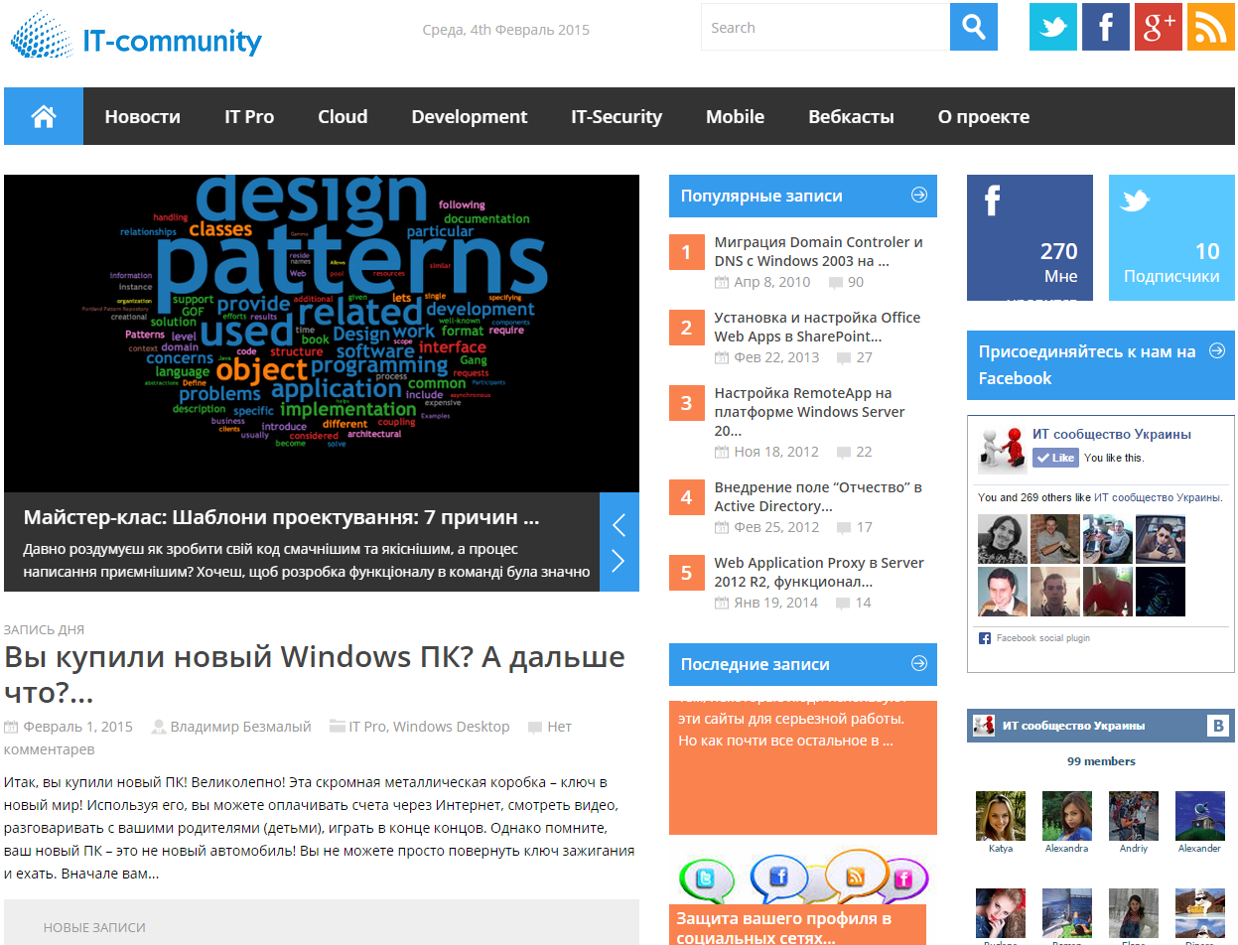
New partnership – IT-community.in.ua

Slide 7

New tools - github
Azure UA Community materials bucket https://github.com/ azureua

Slide 8
Take action!
Like
Plus
Tweet
Share

